Slide 1

Online Food Ordering Website for Restaurant
Submitted by: Mannu Kumar

Slide 2
Introduction
An online food ordering website for a restaurant can be an asset for both the restaurant and its customers. It can help the restaurant to increase sales and improve customer convenience. It can also help customers to discover the restaurant and its menu, and to place orders quickly and easily.
The main purpose of an online food ordering website for a restaurant using HTML, CSS, and PHP is to provide a way for customers to browse the menu, select items, and customize their orders online. The website should also allow customers to create an account, place orders, and track their order status. Once the order is placed, it is sent directly to the restaurant, where it can be prepared and delivered or picked up by the customer.

Slide 3

Scope of Project
The scope of an online food ordering website for a restaurant using HTML, CSS, and PHP can vary depending on the specific needs of the restaurant and the resources available.
However, some of the core features that should be included in the scope of the project are:
Menu management: The website should allow the restaurant to manage its menu online, including adding, editing, and removing items.
Order processing: The website should allow customers to place orders online and track their order status.
Payment processing: The website should be integrated with a payment processor to allow customers to pay for their orders online.
Delivery tracking: If the restaurant offers delivery, the website should allow customers to track their delivery driver's progress on a map.
Customer accounts: Customers should be able to create accounts to save their contact information and shipping addresses.
Reviews: Customers should be able to leave reviews of the restaurant and its food.

Slide 4
Modules
There are two modules in this project, these are: -
1. Admin
2. User

Slide 5
Functionalities of Admin Module
In admin module, the admin is just as administrator. The functionalities of this module are to create an admin(user), create a category of food and manage the food, add the food, delete, and update the food, manage the order of food.
The admin played a lead role in this project. The whole functionality, that will be provided by the user, is controlled by the admin only.
Admin: -- In this module, the main admin adds the user, changes the password, updates, and deletes the admin.
Category: -- This module has functions to add the food category and update and delete the category of food.
Food: -- In this module having functionality to add the food inside the different category. If any of the categories is active in nature, then that food is only visible in the user interface. Also delete the food and update the food.
Order: -- In this module, having display only the order detailed. Only the order details like delivered on the way that will be controlled by the admin itself, means admin update the order at time to time. If the order is delivered, then the admin deletes the order as their choice

Slide 6
Functionalities of User Module
The user module started from the login interface. That required the contact number of user and password which is entered at the time of registration. Once the user is legginged successfully then the user interface is open. In this interface, there are four functionalities that is controlled by the user. These are: -- Home, category, Food and Contact.
Home: -- In this module, the interface is displaying user friendly and attractive. It controls some categories of food that is active, and features are available and food that is also active in nature.
Category: -- This module has displayed all the active and inactive category.
Food: -- It displayed all the food that is stored by the admin as in backend. If the user wants to purchase this food, then they click on the order now button, and fill the details and conform the order.
Contact: -- In this module is working to contact with admin also give the feedback of the food and order of the food

Slide 7
Tools and Technology
Technology: --
In front end design, the technology used these are: --
1. HTML, CSS, JS
2. Bootstrap
In back-end design, the technology used these are: -- 1. PHP: -- As the connection of database and design the user friendly.
2. MySQL: -- As the database purpose
Tools: --
The coding part is done by the VSCode.

Slide 8
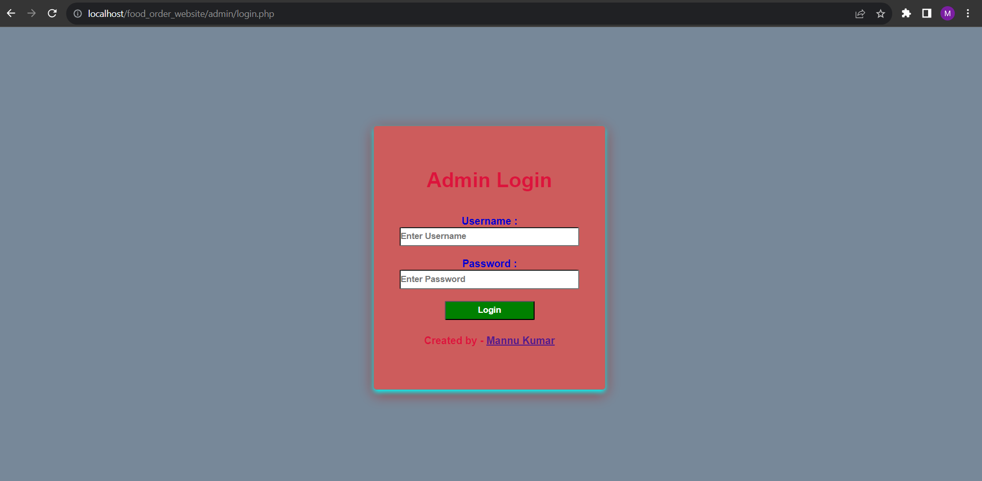
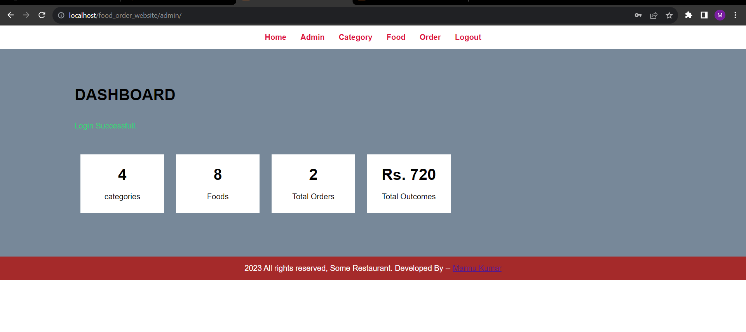
Screenshots

Slide 9
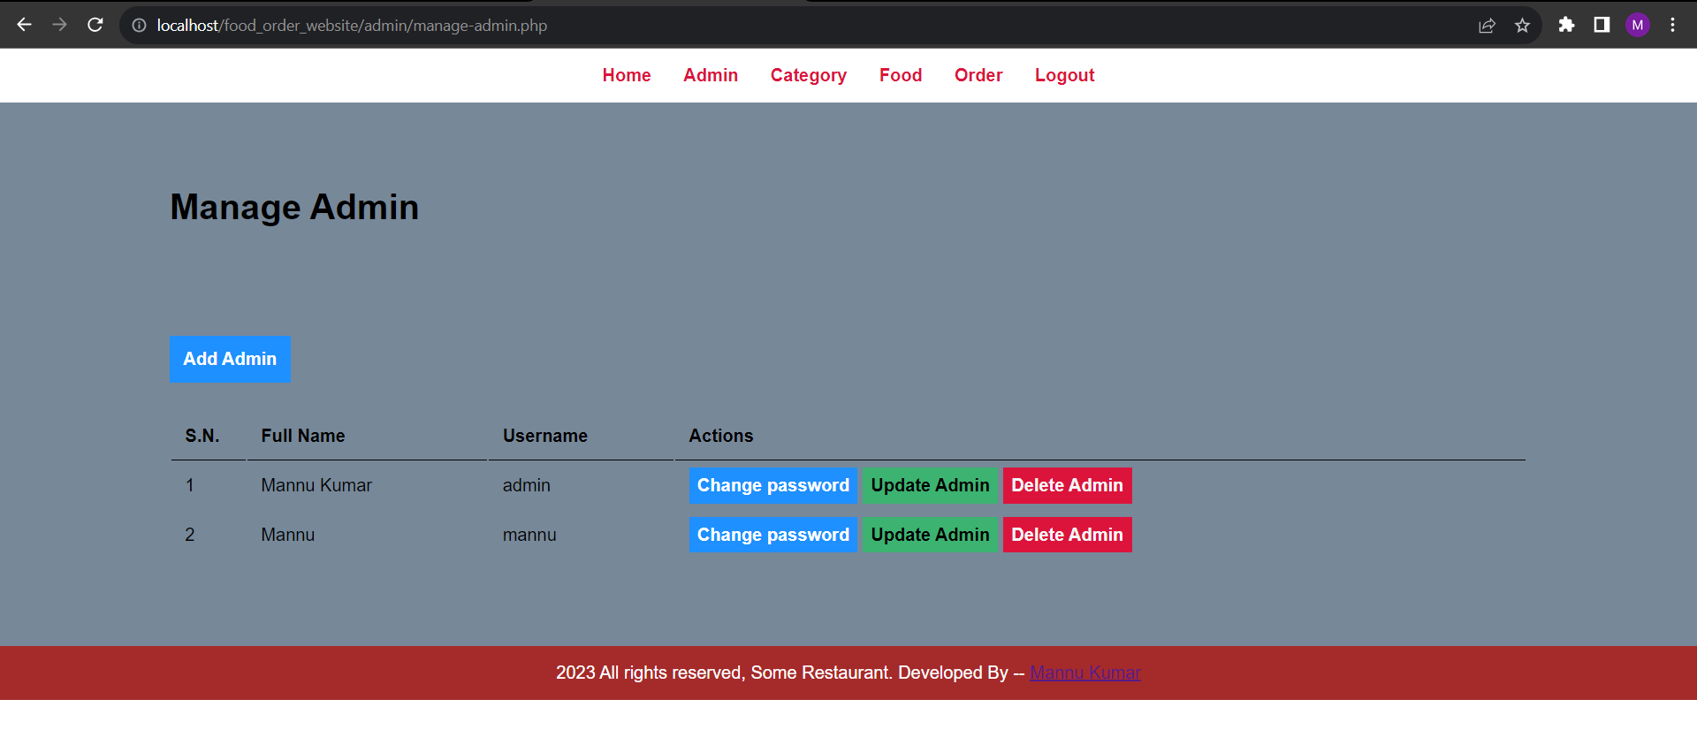
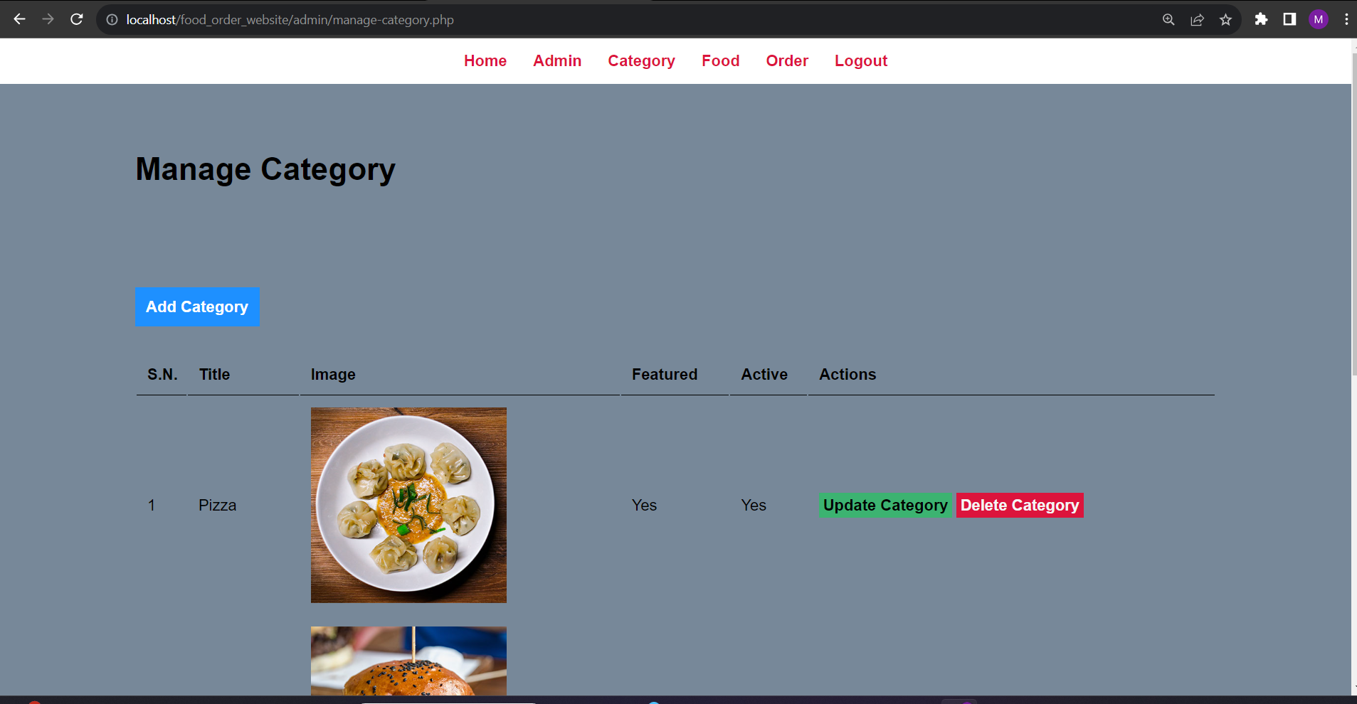
Screenshots

Slide 10
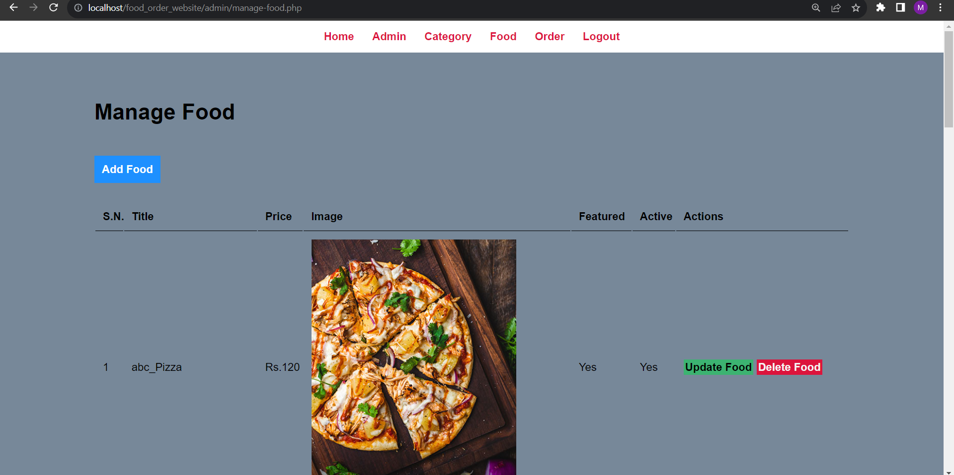
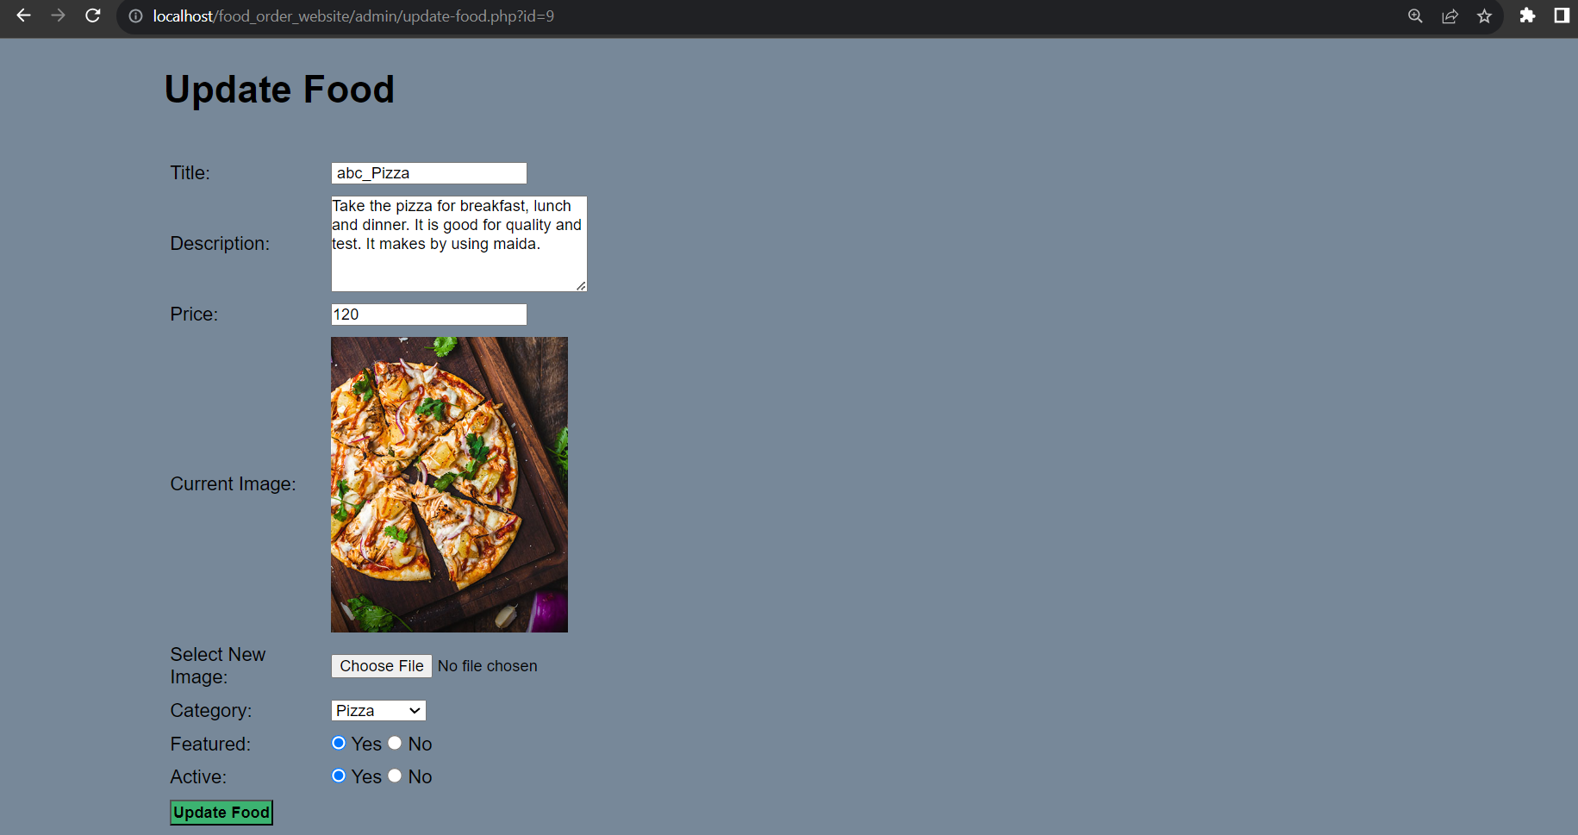
Screenshots

Slide 11
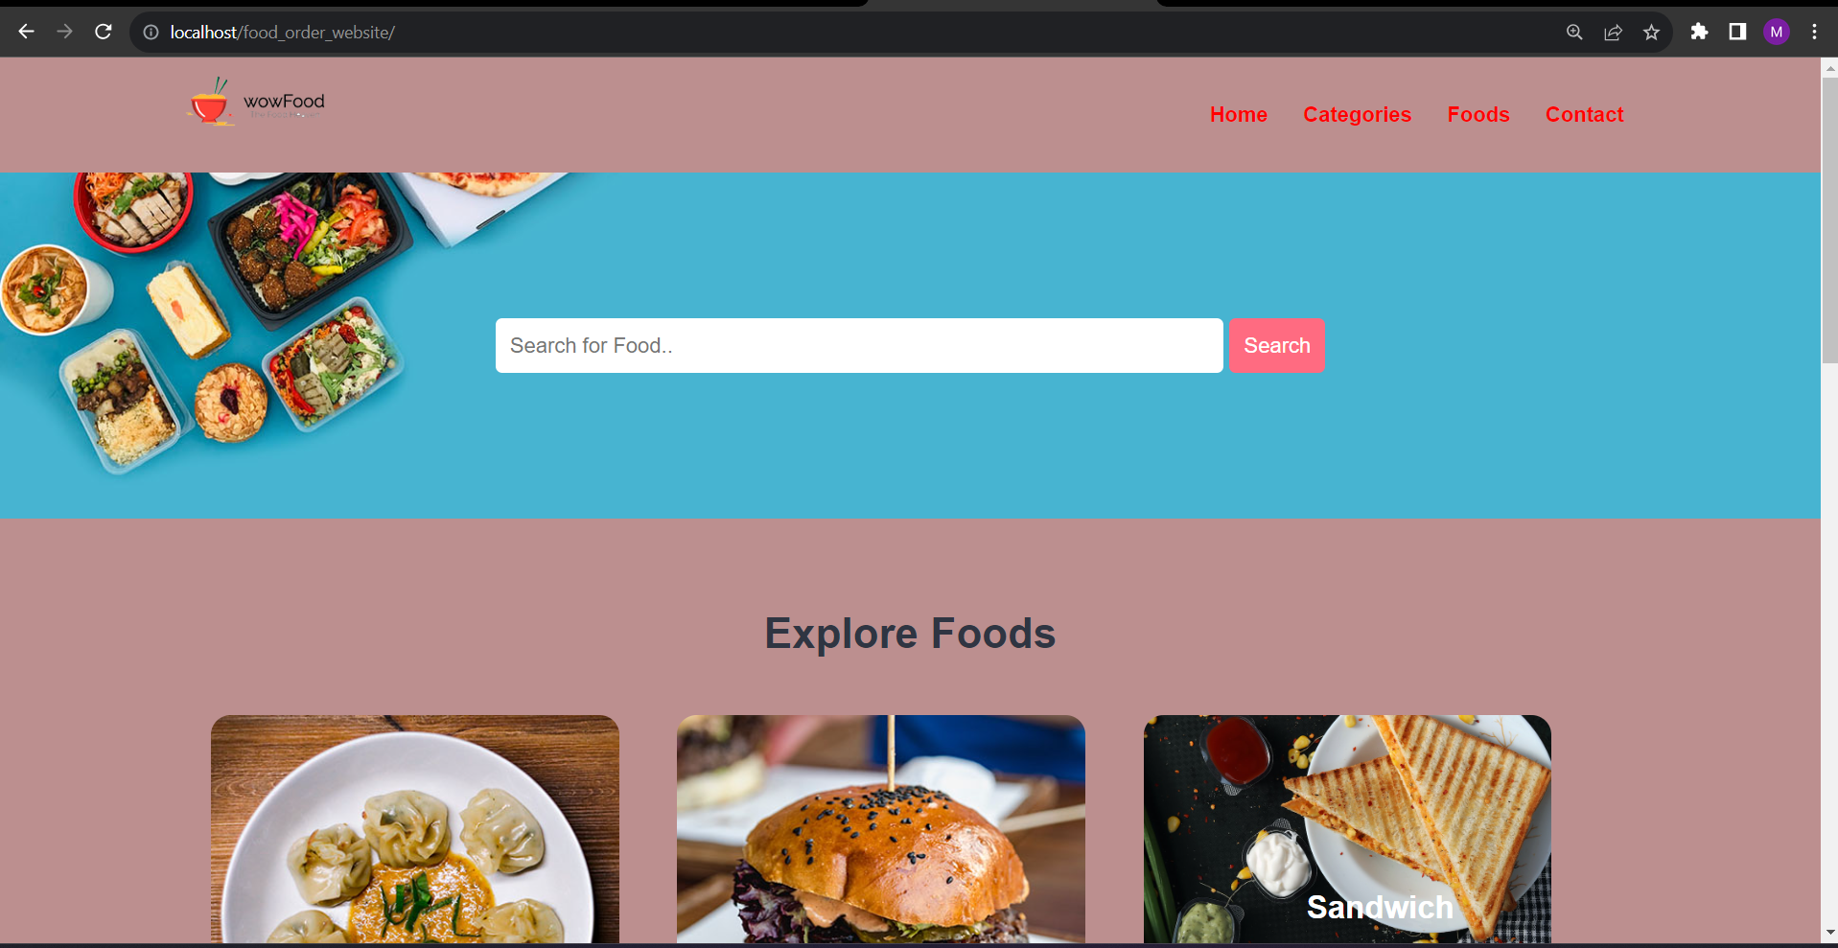
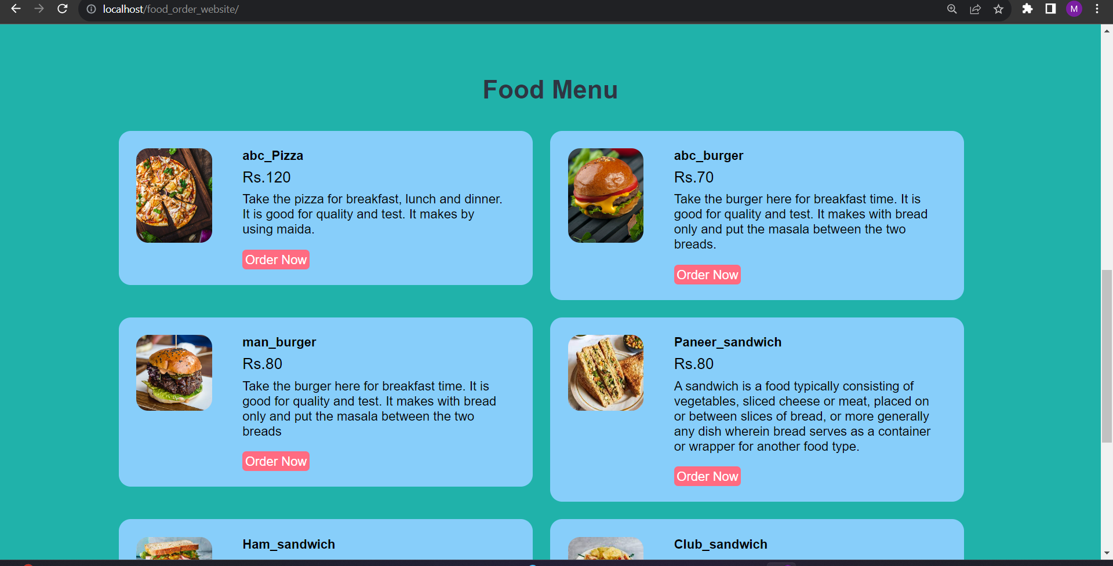

Screenshots

Slide 12
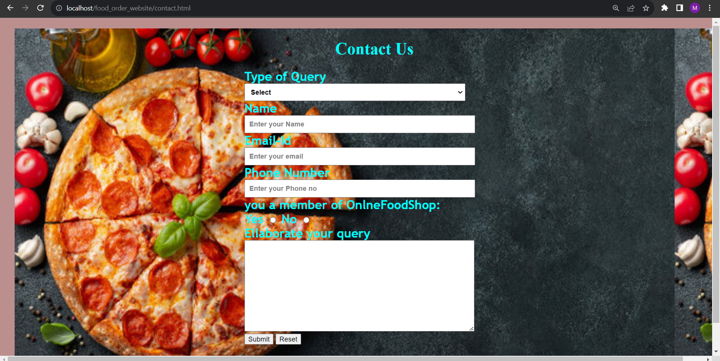
Screenshots

Slide 13
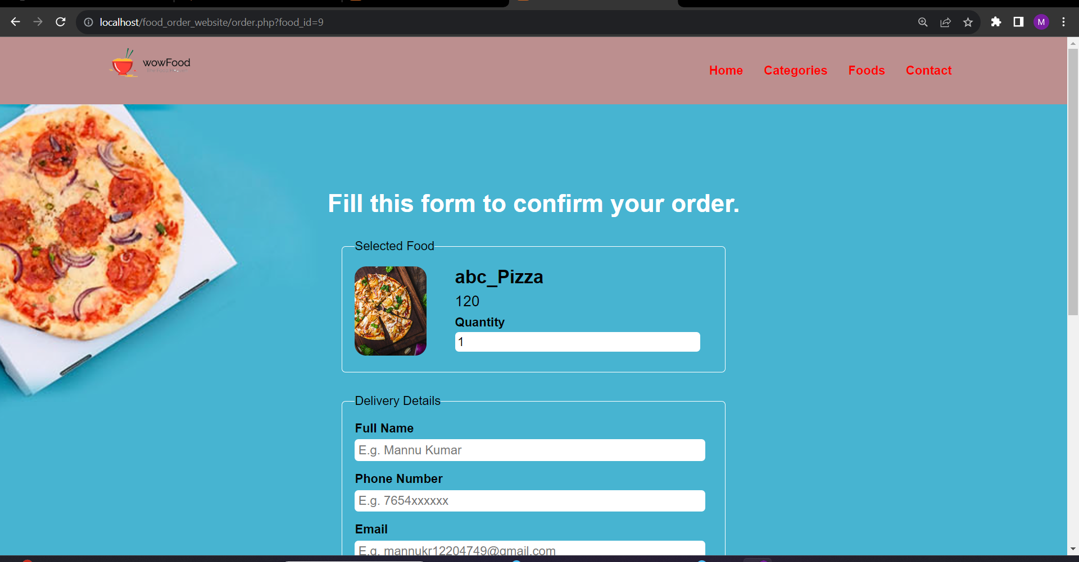
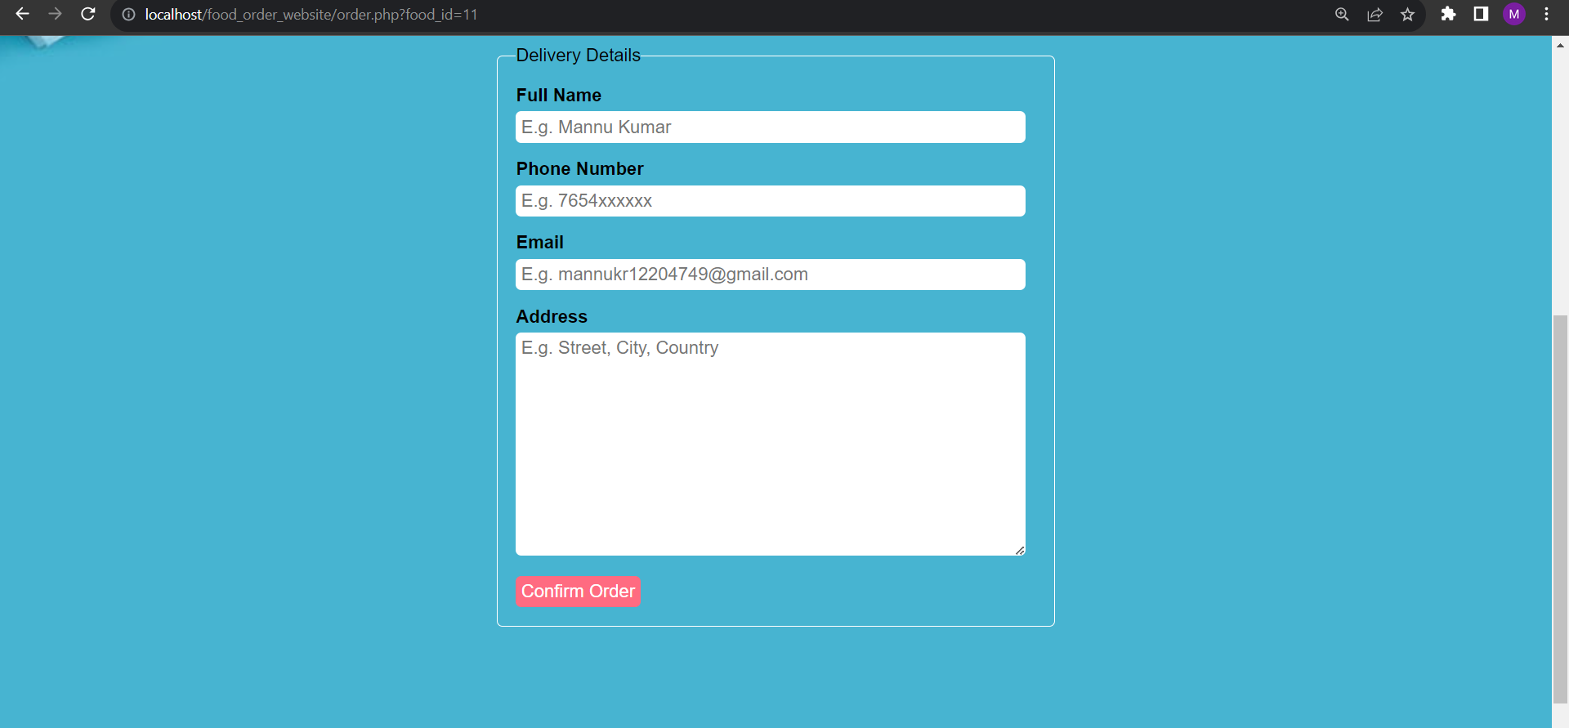
Screenshots

Slide 14

Thank You!!

